Slide 1
Result collection
Info: check slide 7 and 8. Potential

Slide 2
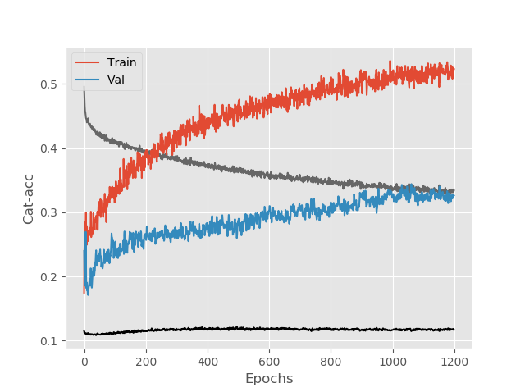
All
array({'label': [1, 2, 4, 6], 'Features': 'all',
'Lookback': 100,
'split': [0.7, 0.3],
'batchsize': 5,
'Epochs': 1200, 'hidden_units': 32,
'dropout': 0.5, 'learning_rate': 0.001, 'learning_rate_decay': 0.1, 'fold': 4,
‘Data-scale: 0, 1’
'model': 'LSTM_model_3_advanced'}

Slide 3
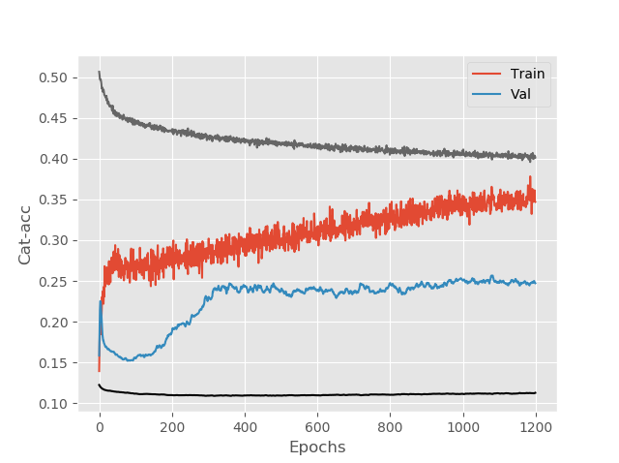
All
array({'label': [1, 2, 4, 6], 'Features': 'all',
'Lookback': 100,
'split': [0.7, 0.3],
'batchsize': 5,
'Epochs': 1200, 'hidden_units': 32, 'dropout': 0.5, 'learning_rate': 0.0001, 'learning_rate_decay': 0.0,
'fold': 4,
‘Data-scale’: 0 1
'model': 'LSTM_model_3_advanced'},

Slide 4
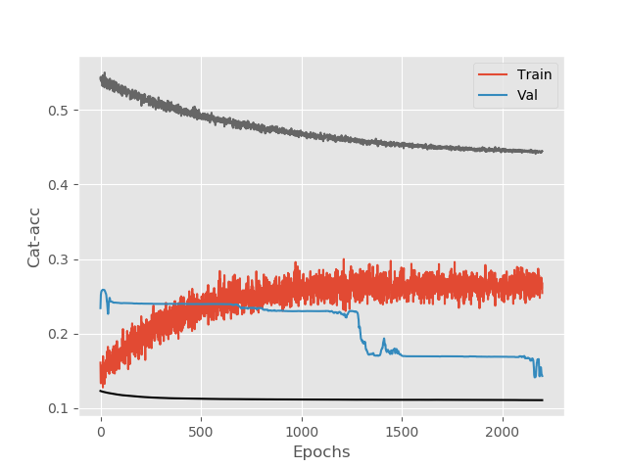
All
'label': [1, 2, 4, 6],
'Features': 'all',
'Lookback': 200,
'split': [0.7, 0.3],
'batchsize': 5,
'Epochs': 2200, 'hidden_units': 32,
'dropout': 0.9,
'learning_rate': 0.0001, 'learning_rate_decay': 0.0, 'fold': 6,
'Data-scale': (0, 1), 'model': 'LSTM_model_3_advanced'

Slide 5
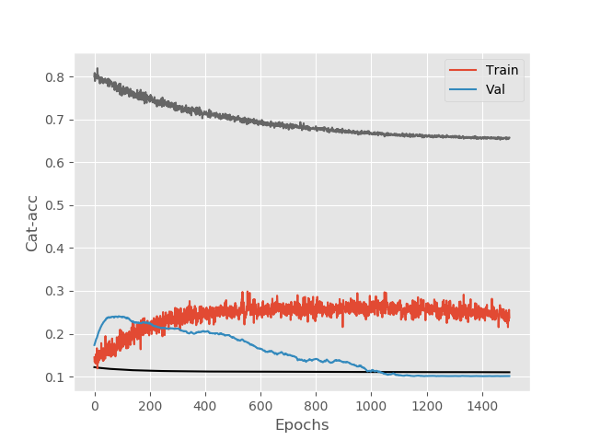
All
'label': [1, 2, 4, 6],
'Features': 'all',
'Lookback': 1337,
'split': [0.7, 0.3],
'batchsize': 1,
'Epochs': 1500, 'hidden_units': 32, 'dropout': 0.9, 'learning_rate': 0.0001, 'learning_rate_decay': 0.0, 'fold': 6,
'Data-scale': (-1, 1),
'model': 'LSTM_model_3_advanced'

Slide 6
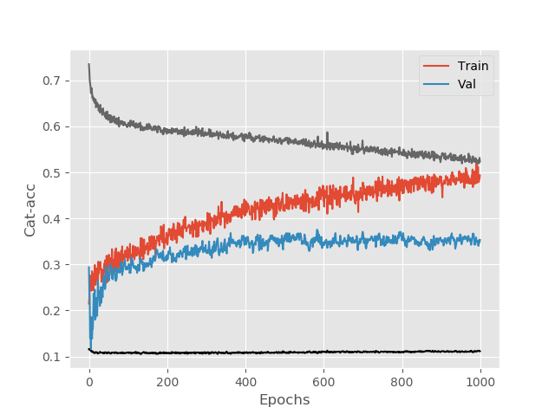
All (first one)
'label': [1, 2, 4, 6],
'Features': 'all',
'Lookback': 1337,
'split': [0.7, 0.3],
'batchsize': 1,
'Epochs': 1000, 'hidden_units': 32, 'dropout': 0.5, 'learning_rate': 0.001, 'learning_rate_decay': 0.0, 'fold': 4,
'Data-scale': None (only standardized),
'model': 'LSTM_model_3_advanced'

Slide 7
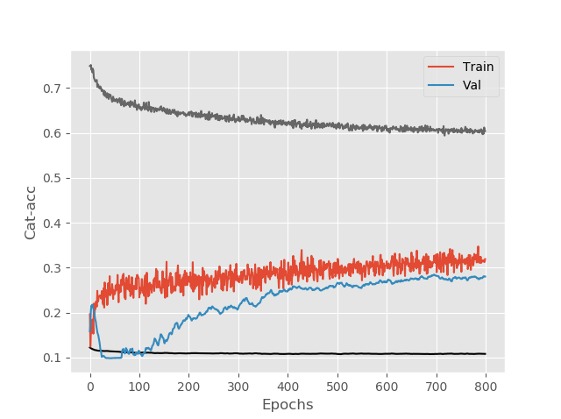
All
'label': [1, 2, 4, 6],
'Features': 'all',
'Lookback': 1337,
'split': [0.7, 0.3],
'batchsize': 1,
'Epochs': 800,
'hidden_units': 32,
'dropout': 0.5,
'learning_rate': 0.0001, 'learning_rate_decay': 0.0,
'fold': 4,
'Data-scale': None (only standardized),
'model': 'LSTM_model_3_advanced'

Slide 8
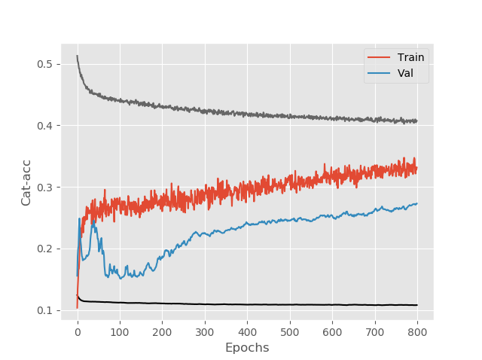
All
{'label': [1, 2, 4, 6],
'Features': 'all',
'Lookback': 100,
'split': [0.7, 0.3],
'batchsize': 5,
'Epochs': 800,
'hidden_units': 32,
'dropout': 0.5,
'learning_rate': 0.0001, 'learning_rate_decay': 0.0, 'fold': 4,
'Data-scale': None (only standardized),
'model': 'LSTM_model_3_advanced'}

